Slide 1
Capstone Engagement
Assessment, Analysis, and Hardening of a Vulnerable System
Report by
Jose M. Dorado

Slide 2
Table of Contents
This document contains the following sections:
01
Network Topology
02
Red Team: Security Assessment
03
Blue Team: Log Analysis and Attack Characterization
Hardening: Proposed Alarms and Mitigation Strategies
04

Slide 3
Network Topology
‹#›

Slide 4
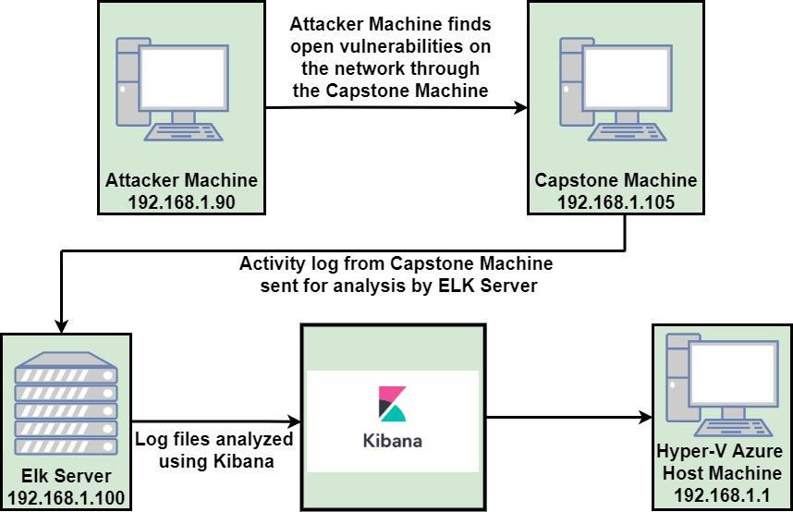
Network Topology
Network
Address Range: 192.168.1.0/24
Netmask: 255.255.255.0
Gateway: 10.0.0.76
Machines
IPv4: 19.168.1.1
OS: Windows 10
Hostname: Aure Hyper-V ML-RefVm-684427
IPv4: 192.168.1.90
OS: Linux 2.6.32
Hostname: Kali
IPv4: 192.168.1.100
OS: Linux
Hostname: Elk-Stack
IPv4: 192.168.1.105
OS: Linux
Hostname: Capstone
Capstone Analysis

Slide 5

Red Team
Security Assessment
‹#›

Slide 6
Recon: Describing the Target
Nmap identified the following hosts on the network:
Hostname | IP Address | Role on Network
Hyper-V Azure Machine ML-RefVM-684427 | 192.168.1.1 | Host Machine Cloud Based
Kali | 192.168.1.90 | Attack Machine
Elk Stack | 192.168.1.100 | Network Monitoring Machine Running Kibana
Capstone | 192.168.1.105 | Target Machine Recreating A Vulnerable Server

Slide 7
Vulnerability Assessment
The assessment uncovered the following critical vulnerabilities in the target:
Vulnerability | Description | Impact
Port 80 found open with public access CVE-2019-6579 | Port 80 was left unsecured and open for public access | All files secret and or sensitive left available and accessible
Root Accessible | Complete open access to root commands on the machine, all resources can be accessed, and altered | Leaves the network open for anytype of malicious attack from stolen or sold of sensitive data to crashing of the network
Common or Weak Passwords | Passwords that are common and weak not using complex numbers, symbols, and capitals | Access to the network and the machine are easily found by social engineering such as for Example: https://crackstation.net/
Common Usernames | Names that are First, Last, and even short can be easily socially engineered | Common or simple password and First, Last, and short names are social engineered to gain open access to all files and folders

Slide 8
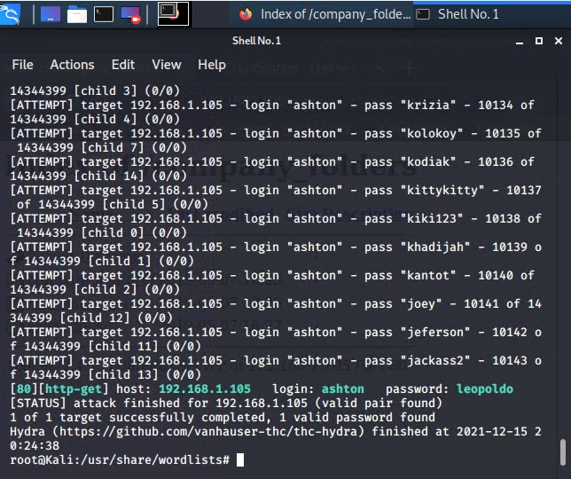
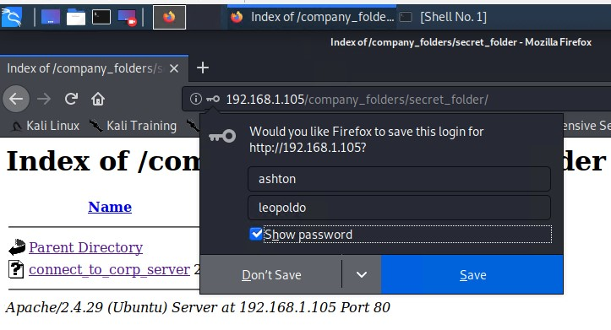
Exploitation: [Brute Force Password]
01
02
03
Tools & Processes
‘Hydra’ was used on my Kali Linux machine to Brute Force the password with a password list by rockyou.txt
Command Used:
$ hydra -l ashton -P /root/Downloads/rockyou.txt -s 80 -f 192.168.1.105 http-get/company_folders/secret_folder
Achievements
With this exploit I was able to login with the name ‘ashton’ and also with the password ‘leopold’
User Access: ‘Achieved’

Slide 9
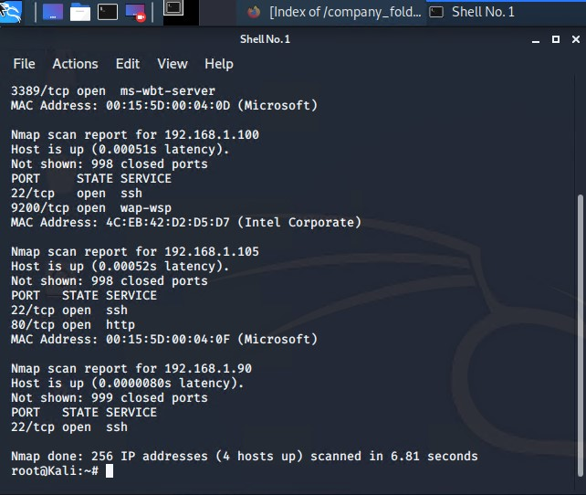
Exploitation: [Exploration Port 80 Open To Public Access]
01
03
Tools & Processes
‘Nmap’ was used to scan for open ports on the target machine
02
Achievements
‘Nmap’ was able to scan 256 IP addresses and found that 4 hosts were up. The Ports of interest were both Port 22 and Port 80.
User Access: ‘Achieved’

Slide 10
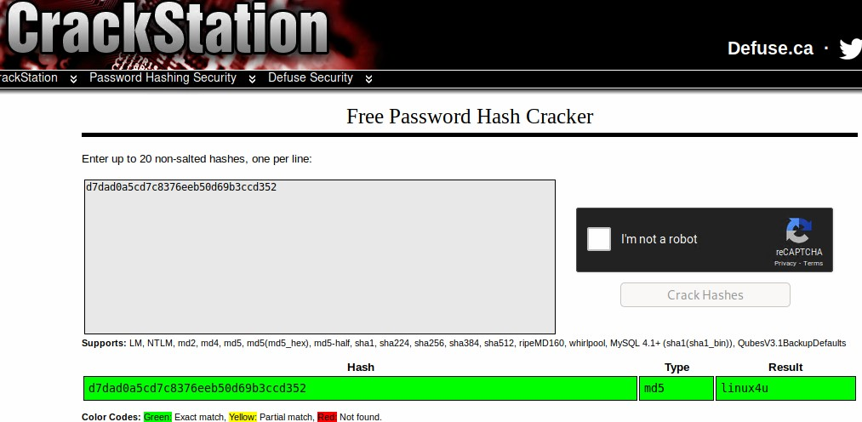
Exploitation: [Exploitation Hashed Passwords]
01
03
Tools & Processes
Website, ‘Crackstation.net’ was used to hash the password
02
Achievements
A password ‘linux4u’ was achieved with the username: ‘Ryan’ to gain access to /webdav folder
User Access: ‘Achieved’

Slide 11

Blue Team
Log Analysis and Attack Characterization
‹#›

Slide 12

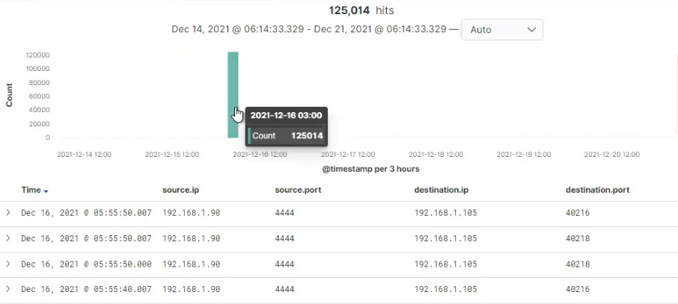
Analysis: Identifying the Port Scan
.
Port scan occurred on December 16, 2021 at 0300 hrs
125,014 connections made from IP 192.168.1.105
Port 4444 scanning showed a sudden high traffic peak

Slide 13
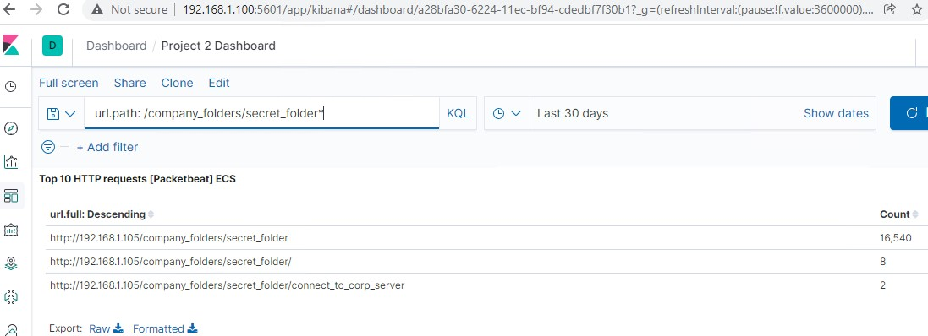
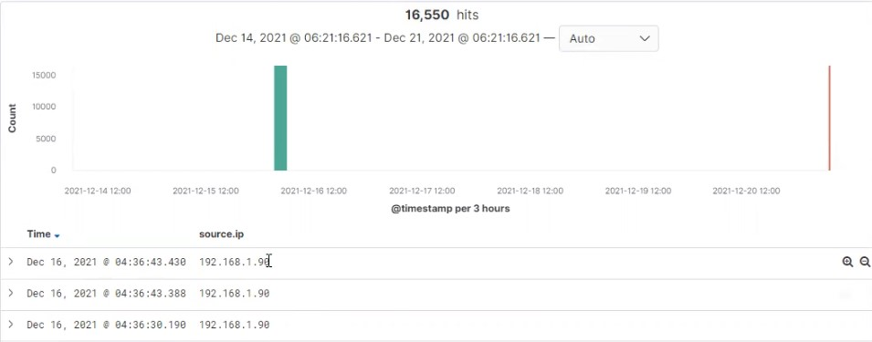
Analysis: Finding the Request for the Hidden Directory
Request at 0436 hrs and a total of 16,550 requests were made
/secret_folder was accessed that contained ‘Ryan’ Password Hash
The compromised /connect_to_corp_server gave me access to upload a payload to search for other vulnerabilities

Slide 14
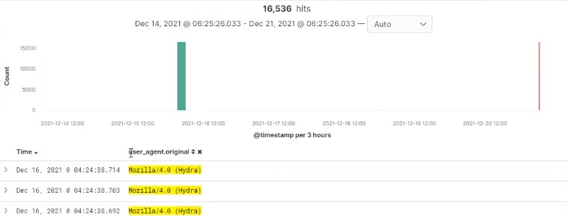
Analysis: Uncovering the Brute Force Attack
There are 16,540 requests were made during the attack
16,536 requests had been made before the attacker discovered the password
HTTP 301 method was being used

Slide 15
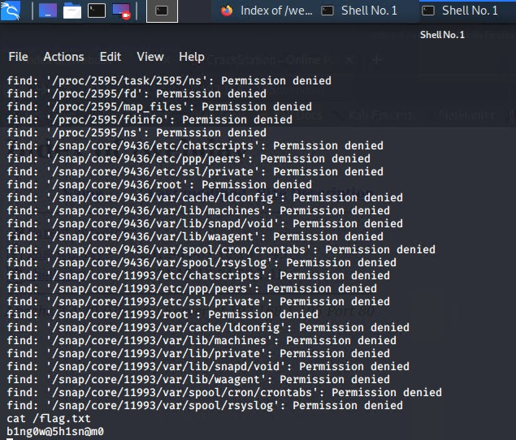
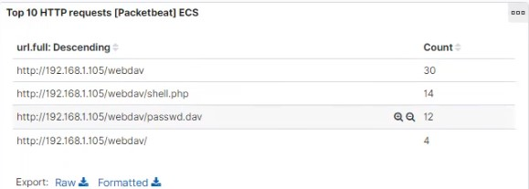
Analysis: Finding the WebDAV Connection
There were 60 requests were made to the /webdav directory
The passwd.dav and shell.php are the files that were requested
Flag Found

Slide 16
Blue Team
Proposed Alarms and Mitigation Strategies
‹#›

Slide 17
Mitigation: Blocking the Port Scan
Alert and drop all traffic packets after no more than a threshold of 1,000 connections that occur within an hour
Block all incoming and outgoing packets until alarm is verified and secured during incident
Set IPtables to drop packets when thresholds are met
Setup and block all unwanted traffic
Patch and update firewalls and software
Audit all ports after after all updates

Slide 18
Mitigation: Finding the Request for the Hidden Directory
Set an alarm to alert as soon as unauthorized access request for any type of critical file or folder
A threshold of no more than 5 attempts per hour
All private and hidden folders are to be secured offline
Use strong passwords that are not common with Capitalization, Symbols, and Numbers
Two factor authentication to be used
Data that is critical should all be encrypted
Use both Black and White list for known bad IP addresses

Slide 19
Mitigation: Preventing Brute Force Attacks
Setup 2 Factor Authentication as a policy
Block out for a period of 2 hours after 5 login attempts
Freeze account if it happens again within 24 hours
Education of employees for repeat offenders
White and black list of all bad IP addresses
Use strong passwords that are not common with Capitalization, Symbols, and Numbers
Setup 401 error alarm when it is brute force is detected
A threshold of 7 should be setup if any login attempts with multiple usernames from the same IP
Abnormal amount of bandwidth being used
Unusual pattern of failed logins

Slide 20
Mitigation: Detecting the WebDAV Connection
Setup an alarm if any suspicious file is being uploaded by anyone other than the admin of the site or Ryan
Let admin know if anyone other admin trying to access WebDav
Only Ryan should be accessing WebDav
Ryans password hash should be removed from the website
WebDav should only be be accessed by Administration if Ryan is locked out
Black list and white list are to be kept up to date
No password hashes are to be kept on the website

Slide 21
Mitigation: Identifying Reverse Shell Uploads
All Port 4444 attempted traffic should have an alarm set when 1 attempt is made by both internal and external attempts
A threshold of just 1 should be set when /webdav folders are trying to be accessed from any IP address that is Black listed and Automatically blocked
All Blacklisted IP addresses shall be kept up to date and new attempted traffic IP addresses will automatically be blocked
All updates to software and hardware will have all ports blocked and configured properly
Read Only will be set to /webdav folders and files

